Slide 1
Fry: A Fast Interactive Biological Pathway Miner
Göknur Giner
The R User Conference 2016 June 28, 2016

Slide 2
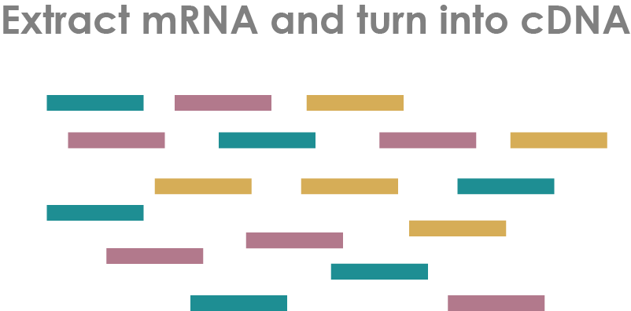
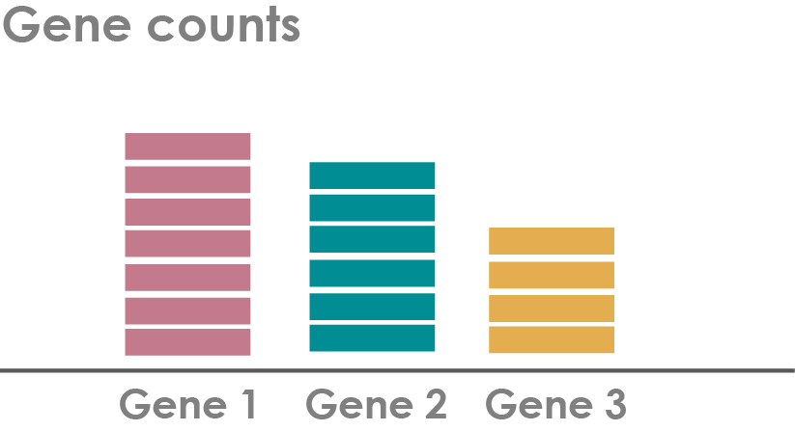
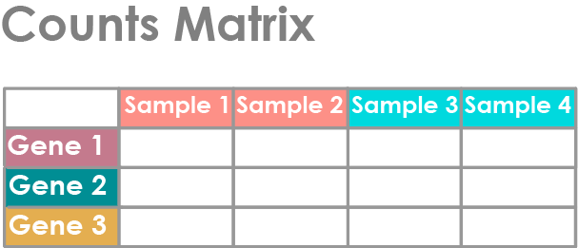
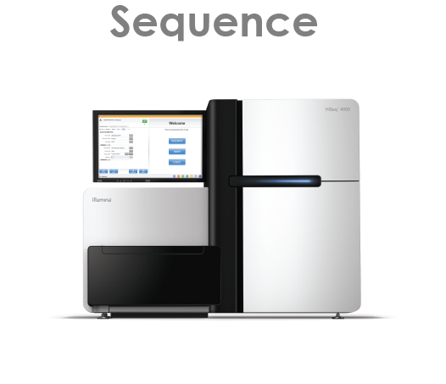
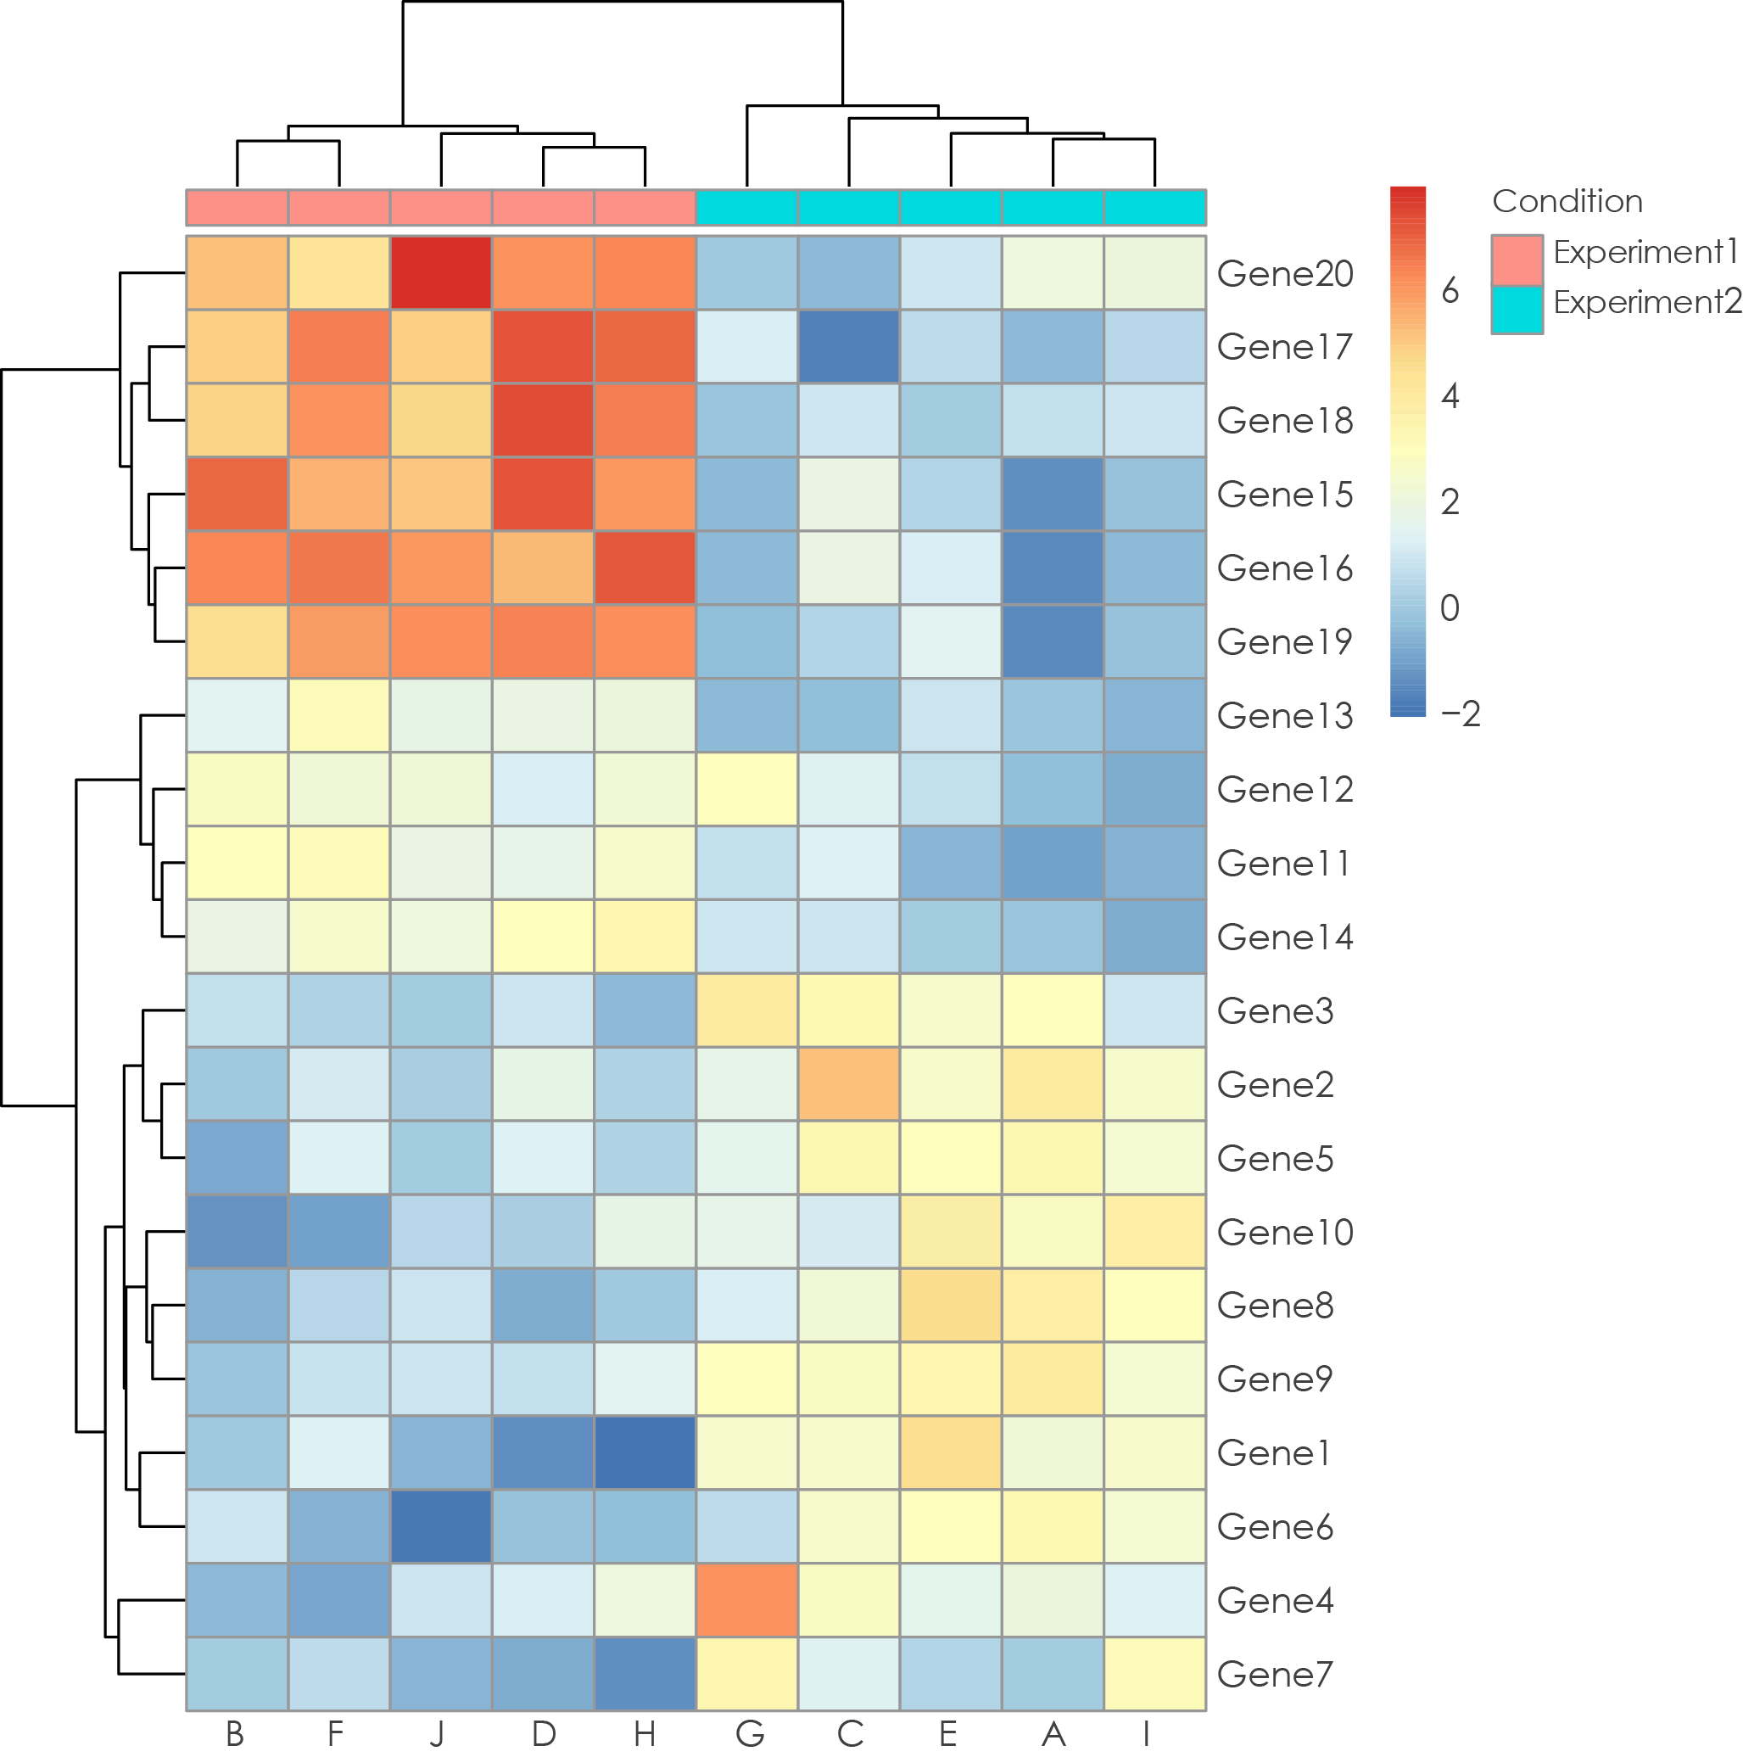
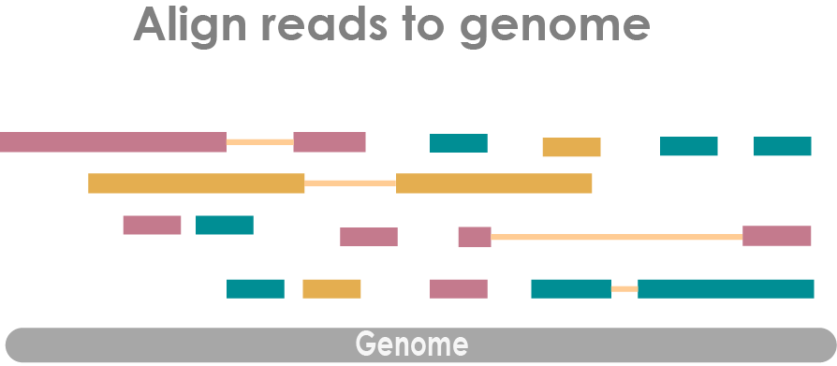
Differential Expression (DE)

Slide 3
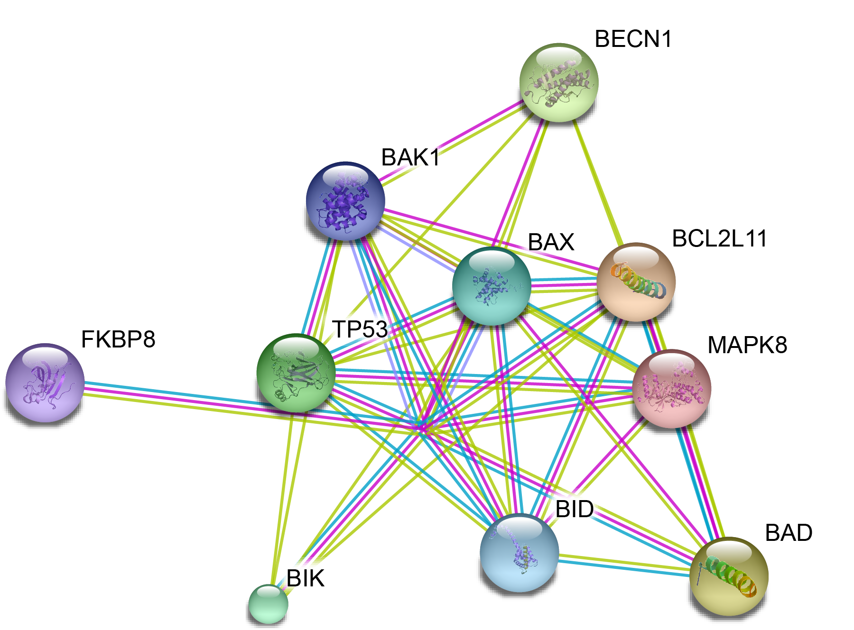
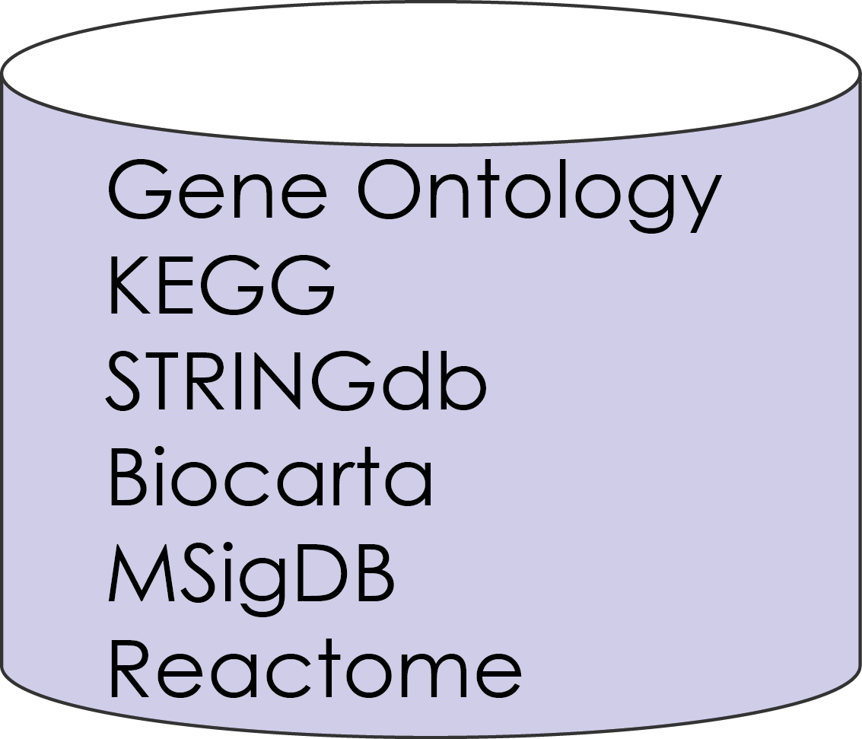
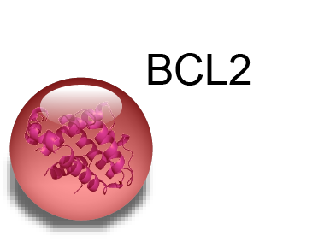
Collection of Genes

Slide 4
Gene Set Tests
Assemble a summary of the most enriched biology
Understand if the biological pathway of interest is changed in a given experiment

Slide 5

Null Hypotheses
Self-Contained Tests
Competitive Tests
Gene Set
Gene Set
Rest of The Genes
vs

Slide 6
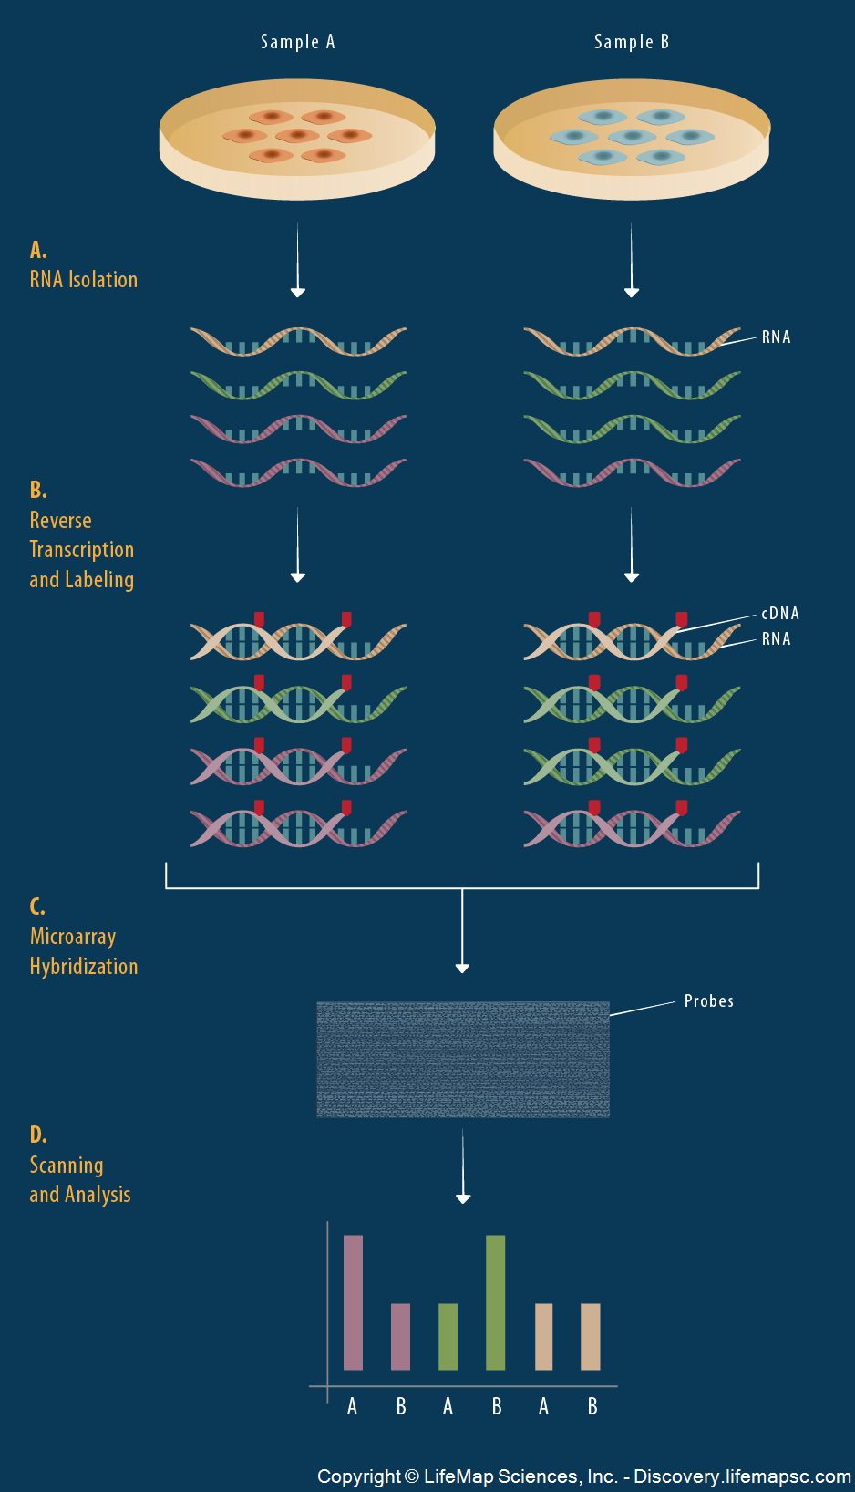
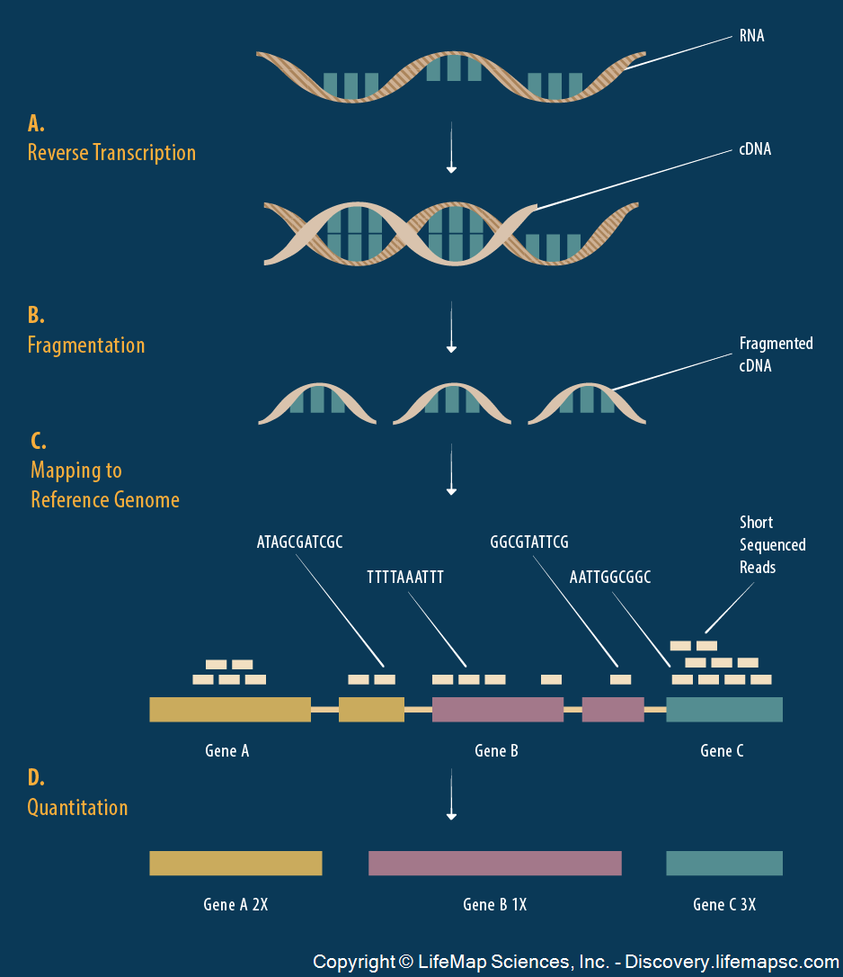

Gene Set Test Methods
Inputs
Methods
DNA Microarrays
RNA Sequencing
Over Representation Analysis (ORA)
List of differentially expressed genes
Fisher exact or Chi-square tests
Pathway Significance
Functional Class Scoring (FCS)
Pathway Database
Count matrix
Gene level statistics
Gene set statistics
Assessment of test statistics

Slide 7
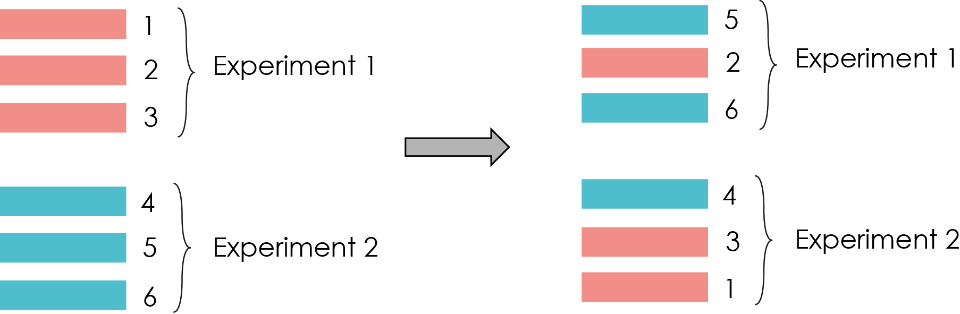
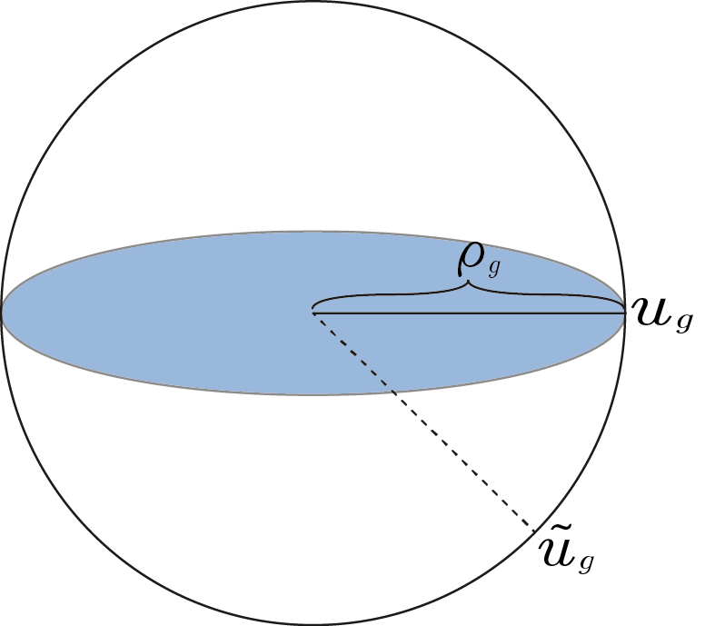
Assessment of Statistical Significance
Permutation Tests
Rotation Tests
Can produce unlimited number of rotated test statistics
Applicable to complex arbitrary experimental designs
Roast: Rotation gene set tests for complex microarray experiments
Require large number of samples
Applicable to limited type of experimental design
Gene Set Enrichment Analysis (GSEA)

Slide 8




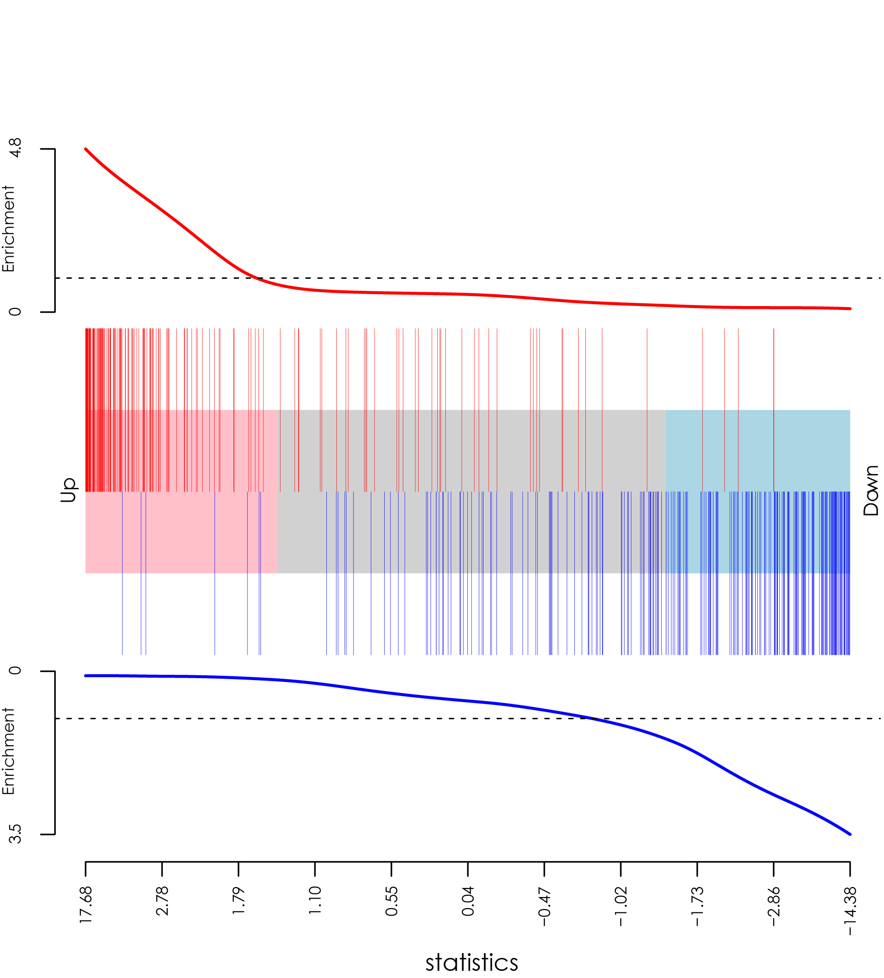
Fry is a Gene Set Testing Method from limma Package
Gordon Smyth
geneSetTest
Camera
Roast
wilcoxGST
Roast
Di Wu
Fry
goana
kegga
Yifang Hu
Barcode plot
Yunshun Chen

Slide 9
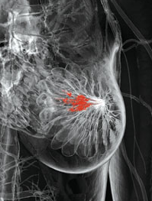
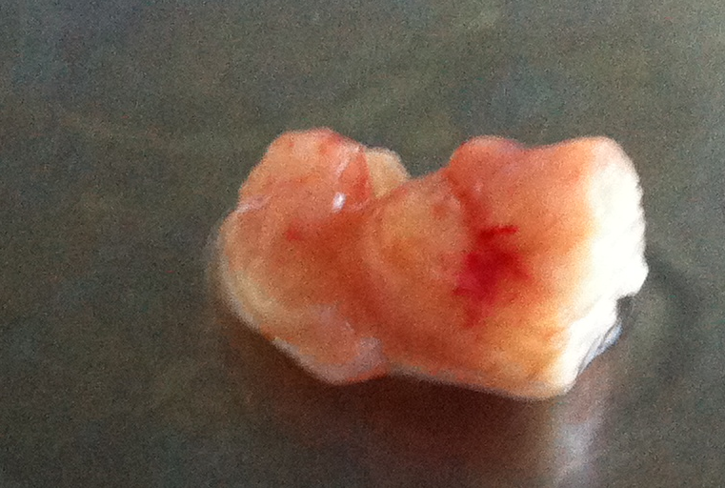
Exploring Biological Processes in Breast Cancer
Design of The Experiment
Human breast tissue biopsies
6 Estrogen Receptor Subtypes
6 BRCA1 Subtypes

Slide 10
Roast vs Fry
Up corresponds to up in ER compared to BRCA1
Both bi-directional
Both applicable to arbitrary designs
Both work well with small sample sizes
Roast uses floor mean, mean50, mean square and mean to aggregate gene set level statistics
Fry uses only mean to aggregate gene level statistics
VANTVEER BREAST CANCER ESR1 UP – 167 Genes
VANTVEER BREAST CANCER ESR1 DN – 235 Genes
Laura J. van 't Veer et al.(2001), Nature

Slide 11
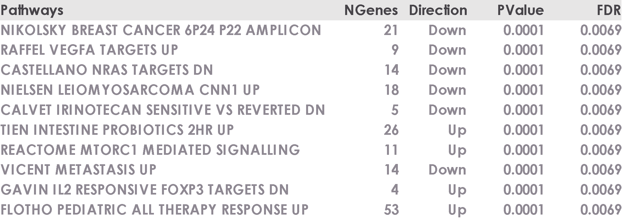
Downsides of Roast
Limitations when analysing large collections of sets
P-value resolution is limited by the number of rotations
Top detected sets are all have the same p-values
P-values for each set may vary from run to run
Roast

Slide 12
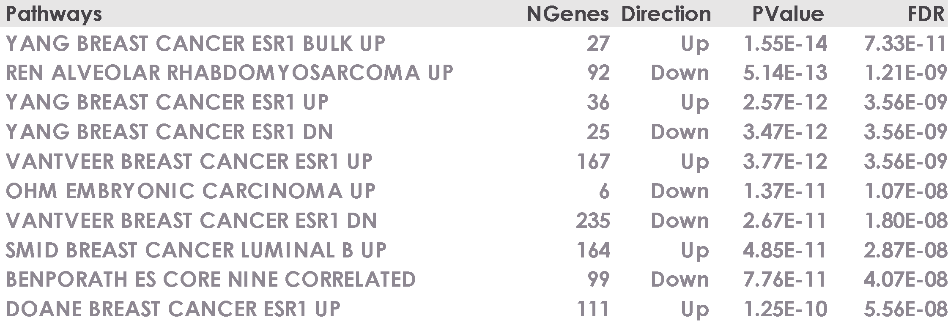
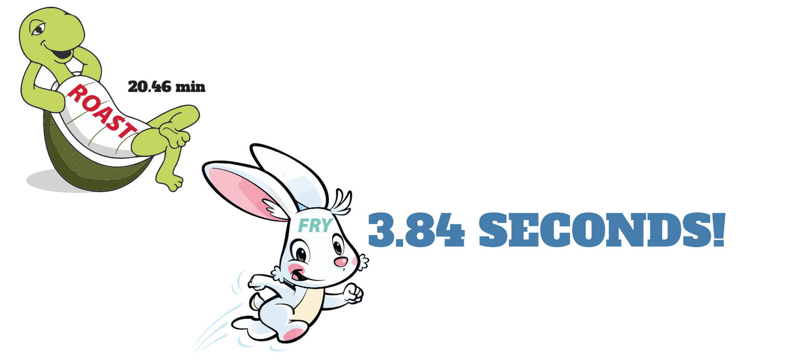
Improved Features with Fry
Assumes equal gene-wise variances
Therefore gene level statistics are standardized using posterior gene variances
Produces high-resolution exact p-values unlike roast
Computationally very efficient
Fry
Over 4000 pathways are tested simultaneously! Roast is rotated 10000 times

Slide 13
Fry Shiny App
Web address
http://shiny.bioinf.wehi.edu.au/giner.g/FRY_GeneSetExplorerApp/
Source code
https://github.com/goknurginer/fry-gene-set-test-shiny-app

Slide 14

Acknowledgements
Bioinformatics Division
Gordon Smyth
Guido Pacini
Breast Cancer Laboratory
Stem Cells & Cancer Division
Jane Visvader
Bhupinder Pal
Delphine Merino
Population Health and Immunity
Roberto Bonelli
Saskia Freytag

